Slide 1
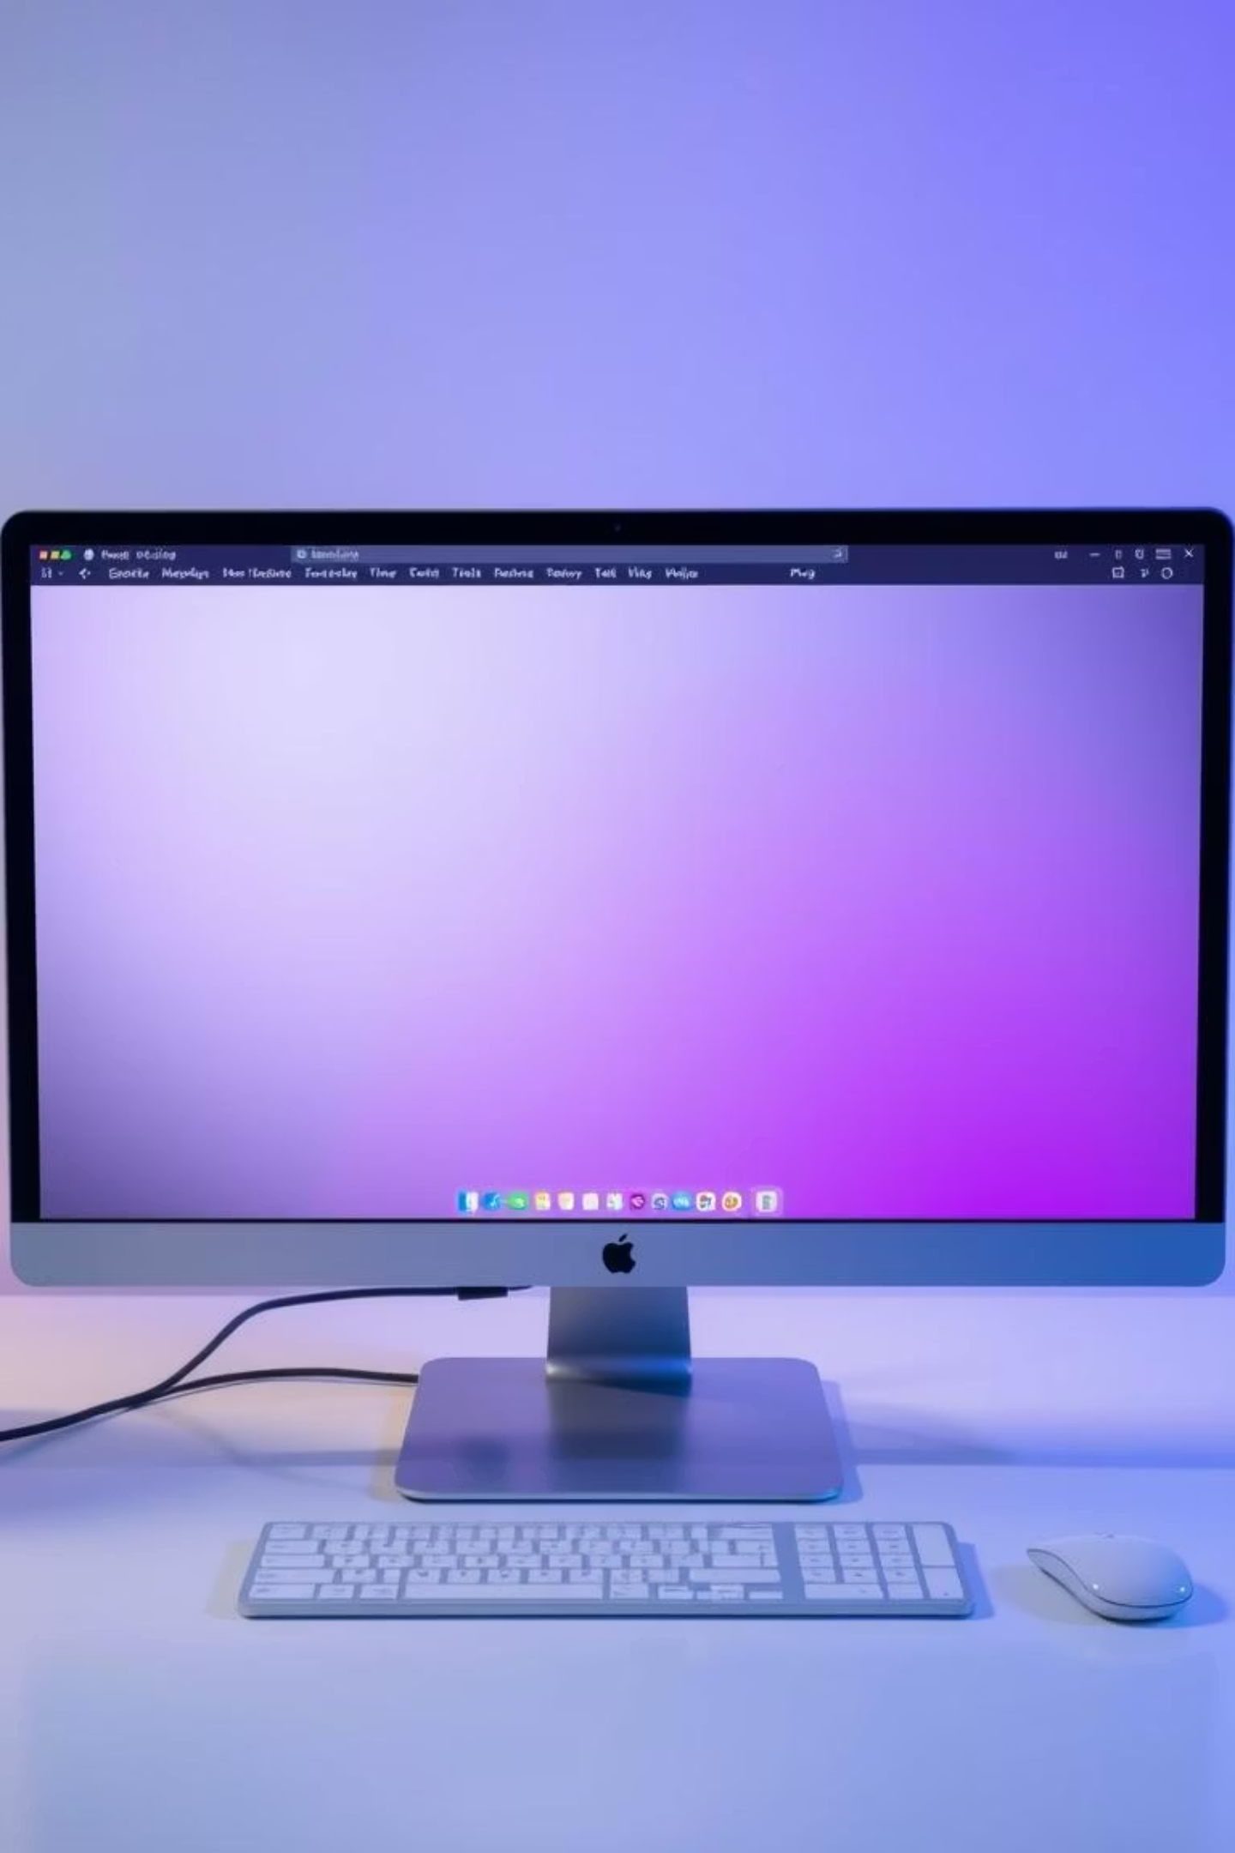
Mood Tasker – Mood Based Productivity Tracker
Welcome to the future of productivity. Mood Tasker is an innovative web application designed to harmonize your tasks with your emotional well-being.
kk
by krisha keraliya

Slide 2

Introduction to Mood Tasker
Mood Tasker is a unique web application developed to enhance productivity by integrating personal mood into task management. It provides a holistic approach to daily planning.
Why it was created
Empowering productivity
To address common challenges like procrastination and lack of focus, by aligning tasks with your current emotional state.
Moving beyond generic to-do lists, Mood Tasker adapts to your inner state, making productivity feel more natural and less overwhelming.

Slide 3

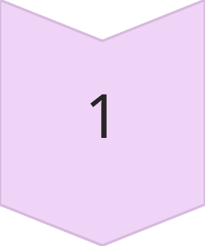
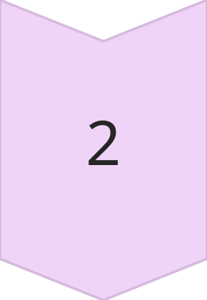
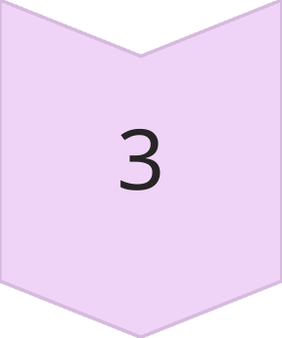
The Problem: Disconnected Productivity
Traditional productivity tools often overlook a crucial element: our mood. This oversight leads to a disconnect between our energy levels and our task demands.
Struggle with Focus
Difficulty concentrating on tasks, leading to unfinished work.
Chronic Procrastination
Delaying important tasks due to feeling overwhelmed or unmotivated.
Lack of Mood-Aware Tools
Existing tools don't adapt to emotional states, increasing stress.

Slide 4

Our Solution: Mood-Centric Productivity
Mood Tasker addresses these challenges by introducing a dynamic, mood-aware framework. It's designed to make productivity intuitive and aligned with your well-being.
1
Mood Selection Integration
Users select their current mood (e.g., 😊😌😫😃), which then influences task recommendations.
2
Tailored Experience
The app suggests suitable tasks and breaks based on your mood, optimizing focus and preventing burnout.
3
Harmonized Workflow
Promotes a balanced approach, ensuring tasks are tackled when you are most effective, enhancing overall well-being.

Slide 5




Core Technology Stack
Mood Tasker is built on a modern, robust, and user-friendly tech stack to ensure a seamless and responsive experience.
ReactJS
Tailwind CSS
For building a dynamic and responsive single-page application interface.
For utility-first styling, enabling rapid and consistent UI development.
Vite
localStorage
As a fast development build tool for a snappy development experience.
For client-side data persistence, ensuring user data is saved locally.

Slide 6







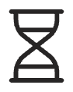
System Flow and Architecture
The system flow of Mood Tasker is designed to be intuitive, guiding users through a seamless loop of mood assessment, task engagement, and mindful breaks.
Task Input
Mood Selection
Tasks are added, optionally guided by mood.
User selects current mood.
Summary & Insights
Break Page
Visual analysis of mood-task correlation.
Timed breaks with mood-based suggestions.

Slide 7
Feature Highlight: Break Page & Suggestions
Our innovative Break Page ensures you get restorative pauses, with suggestions tailored to your emotional state. This minimizes burnout and maximizes effective work time.
Screenshot Placeholder: Insert a high-quality screenshot of the "Break Page" here. It should prominently feature the timer, mood emojis (e.g., 😊 for happy, 😌 for relaxed), and an example relaxation tip (e.g., "Listen to calming music"). Ensure the design reflects the app's calm and uplifting aesthetic with soft gradients and rounded buttons.
Timed Breaks
Integrated timer for structured breaks.
Mood-Based Tips
Suggestions like "Meditate" (😌), "Take a brisk walk" (😃), or "Journal your thoughts" (😫).
Recharge & Refocus
Designed to help you return to tasks refreshed.

Slide 8

Future Enhancements & Outlook
Mood Tasker is a continually evolving project. Our vision extends to integrating more features that deepen its utility and user engagement.
Firebase Sync & User Login
Advanced Analytics
Customizable Notifications
Enabling cross-device access and personalized user profiles for seamless experience.
More detailed insights into productivity patterns and mood correlations.
Personalized reminders for tasks and breaks, enhancing user engagement.

